Slide 1
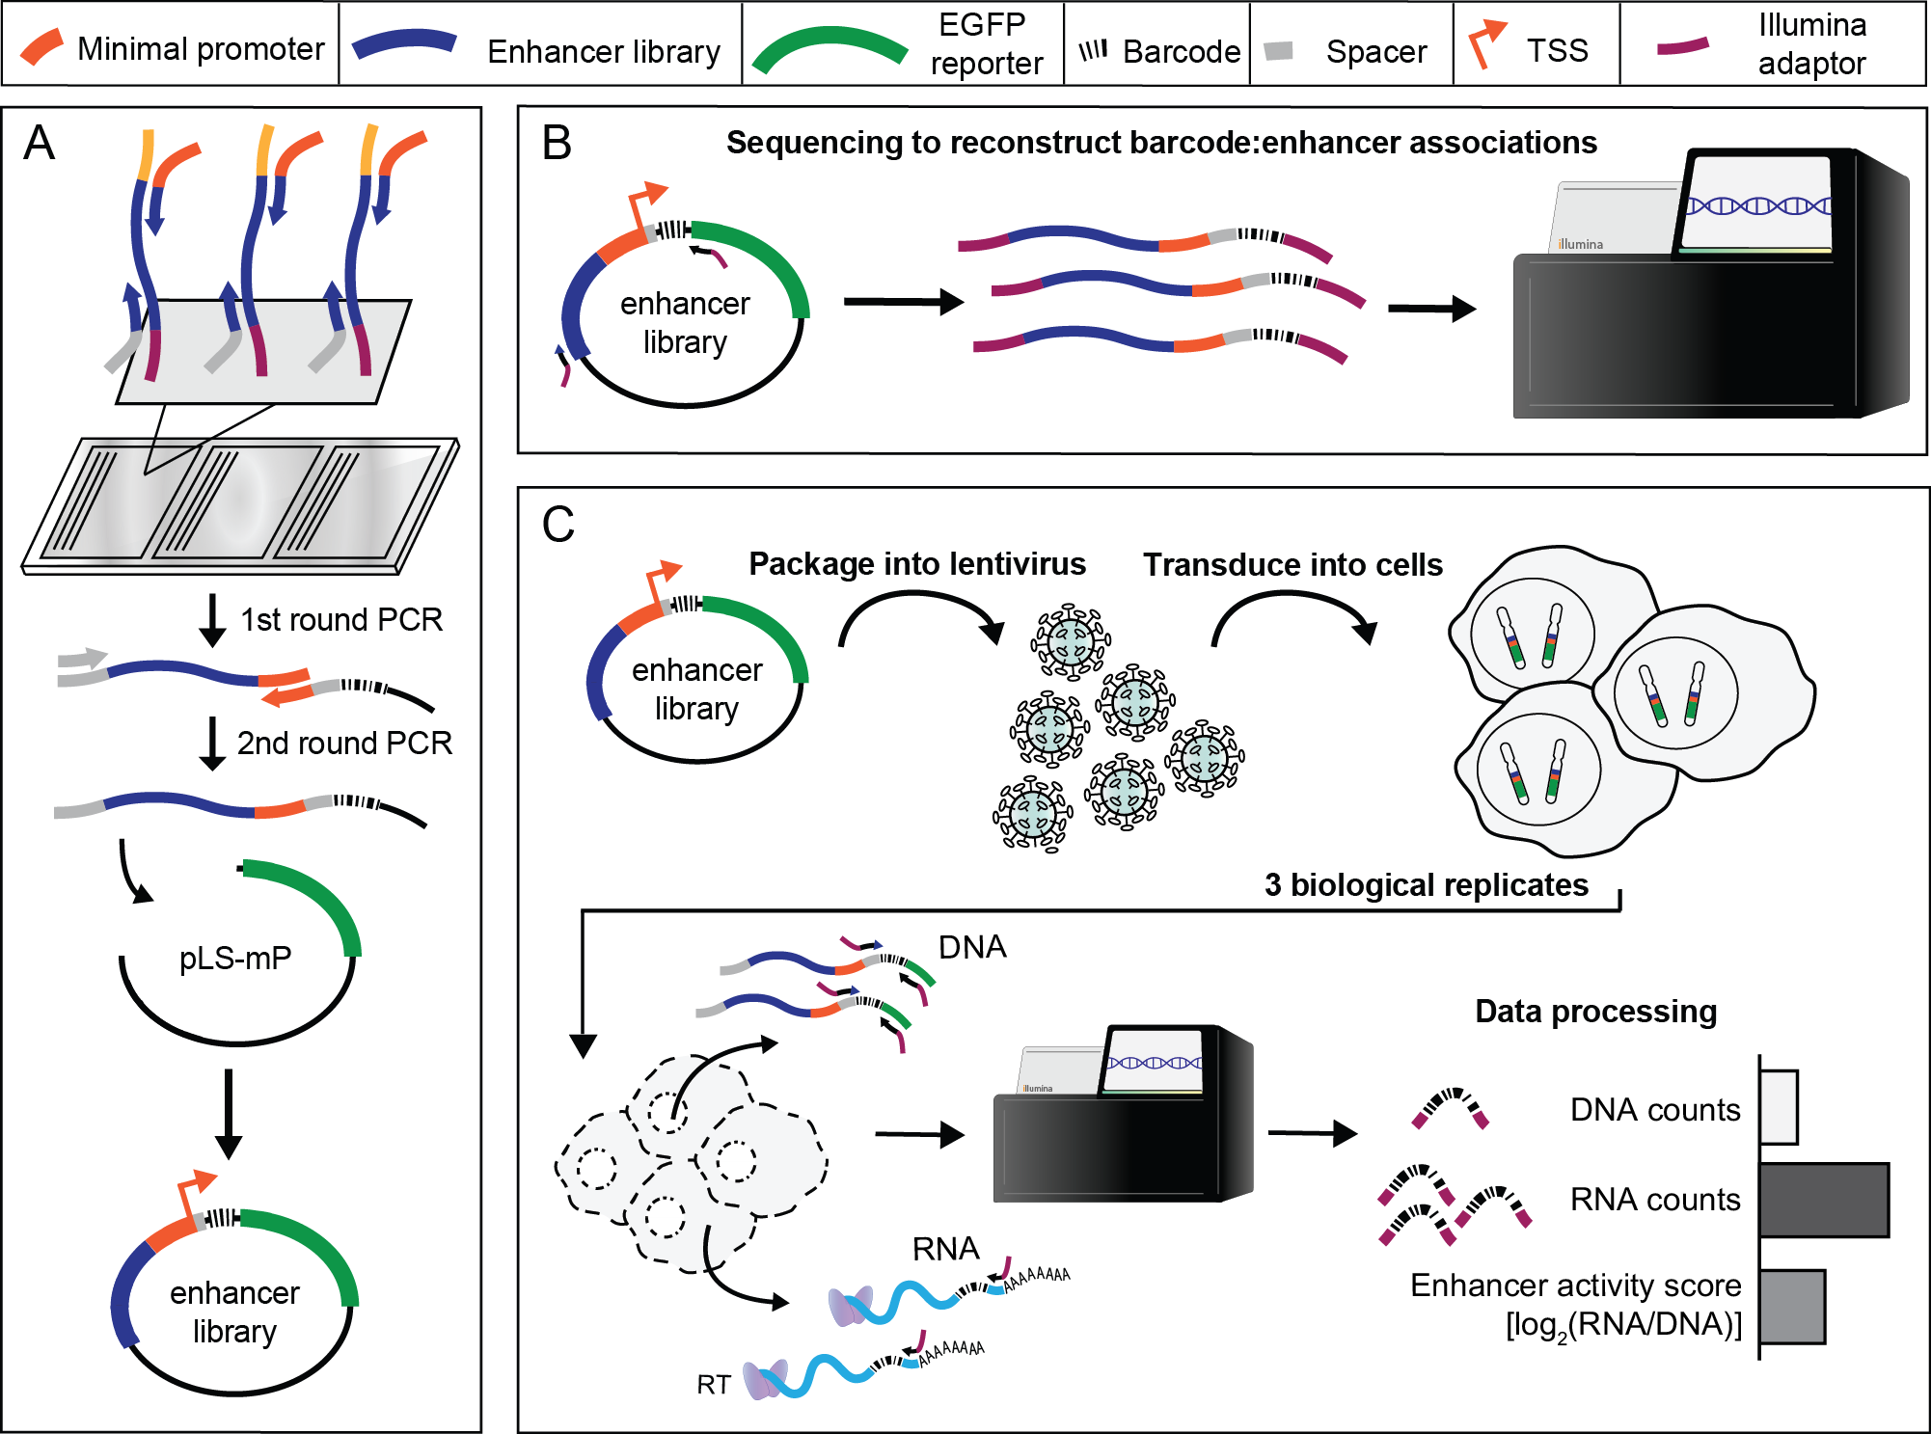
MPRA Schematic
In the past our group has tested ~2,400 candidate enhancers in one experiment

Slide 2
HepG2 Pilot MPRA

Slide 3
HepG2 pilot library of ~9,400 enhancers
50 positive and 50 negative synthetically designed controls from Smith et al, 2013
50 positive and 50 negative naturally occurring controls from Inoue et al, 2017
~9,200 candidate enhancers
Identified DNase I hypersensitivity sites common to 2 replicates
Took the subset not overlapping annotated promoters
Counted number of ENCODE-ChIP-supported TF binding sites overlapping the enhancer, and sampled enhancers from 5 bins
Acquired a sampling of enhancers from across the genome with few and lots of TF binding sites

Slide 4
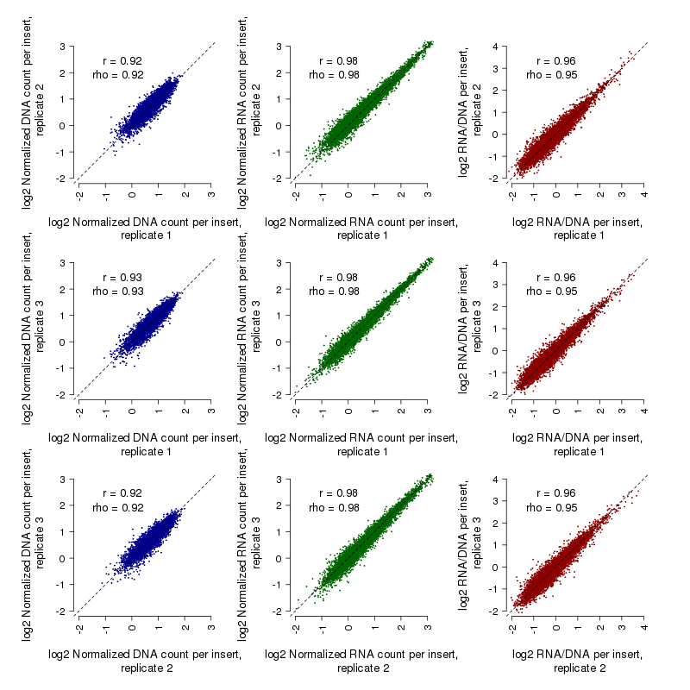
Reproducibility among replicates

Slide 5
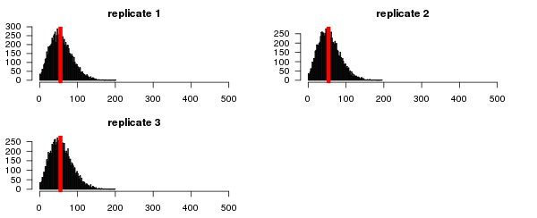
Barcodes / insert in each replicate

Slide 6
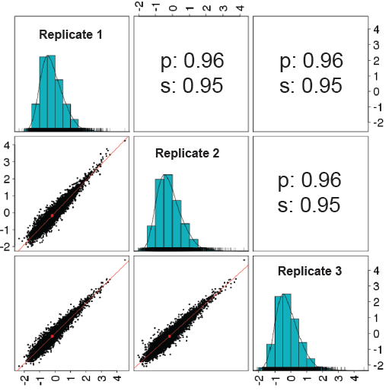
HepG2 pilot library of ~9,400 enhancers

Slide 7
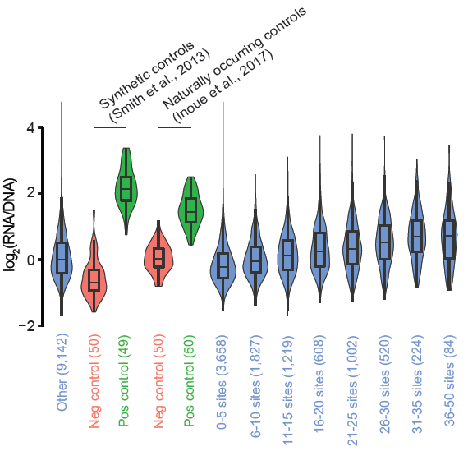
HepG2 pilot library of ~9,400 enhancers

Slide 8
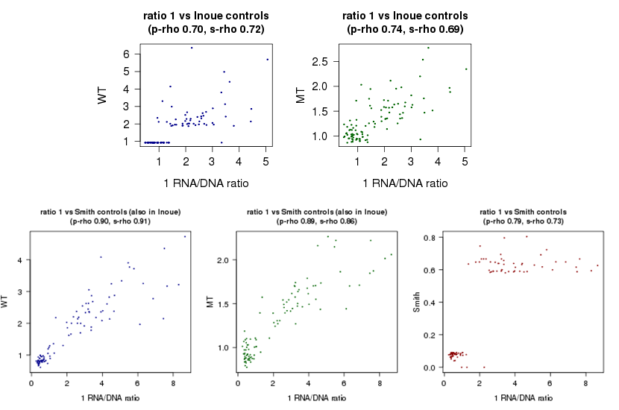
Correlation to controls

Slide 9
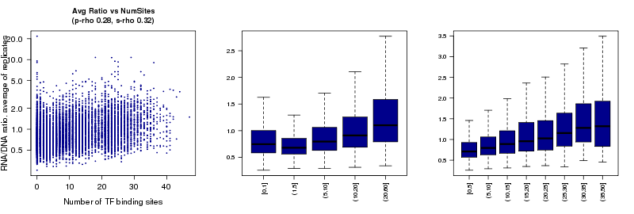
Number of binding sites vs enhancer activity

Slide 10
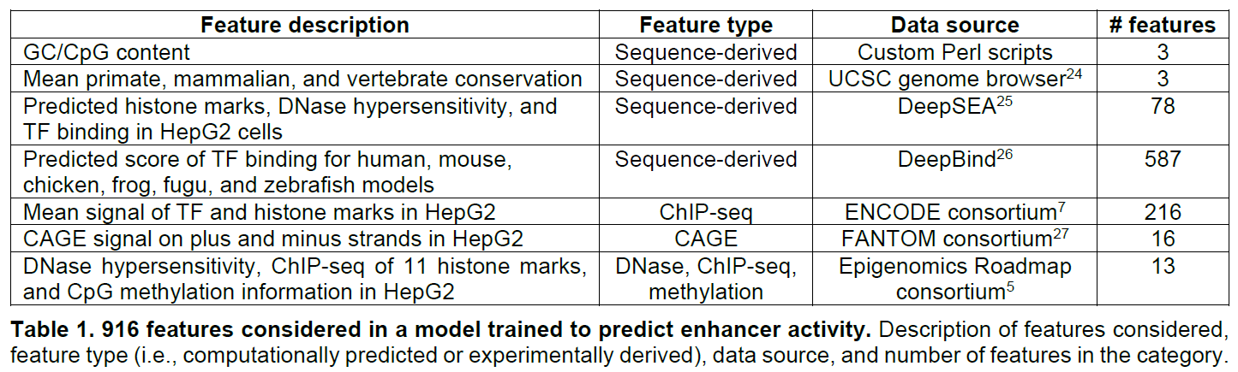
Explaining enhancer activity using a lasso regression model

Slide 11
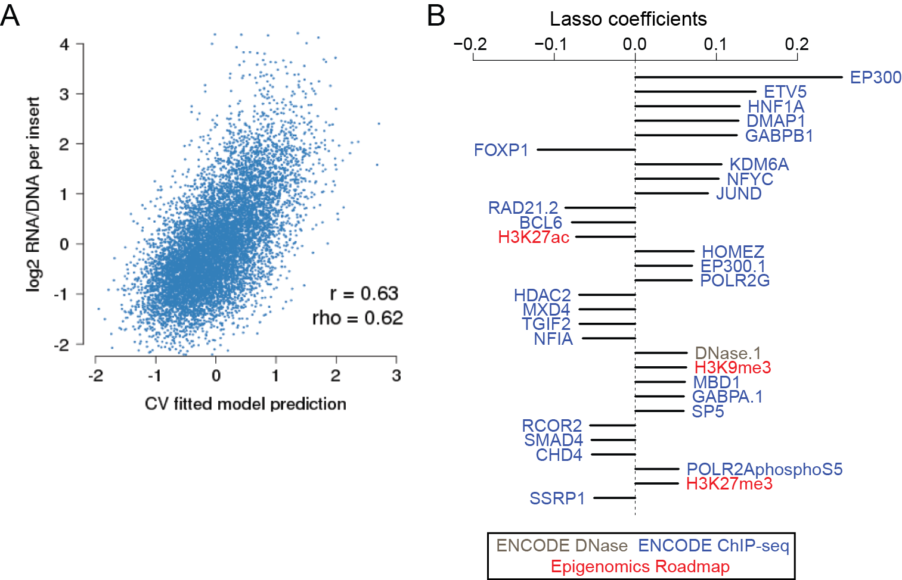
A model to predict enhancer efficacy
Notes:
Foxp1 repressor
Ep300 activating
BCL6 repressor
HDAC6 – deacetylase

Slide 12
Biochemical vs sequence-based models
Time-consuming to collect hundreds to thousands of biochemical marks
Matching marks to cell type of interest is time-consuming and requires careful data curation and pre-processing
Cell types with limited ENCODE data will fair poorly
Prohibitive to compute predictions on a genome-wide scale
Easy to gather DNA sequence and generate a prediction
A universal framework with features that can be easily refit to MPRA data from any cell type or species
Cell types with limited ENCODE data can borrow information from related cell types
Can compute features or predictions on a genome-wide scale with GPU-speed up

Slide 13
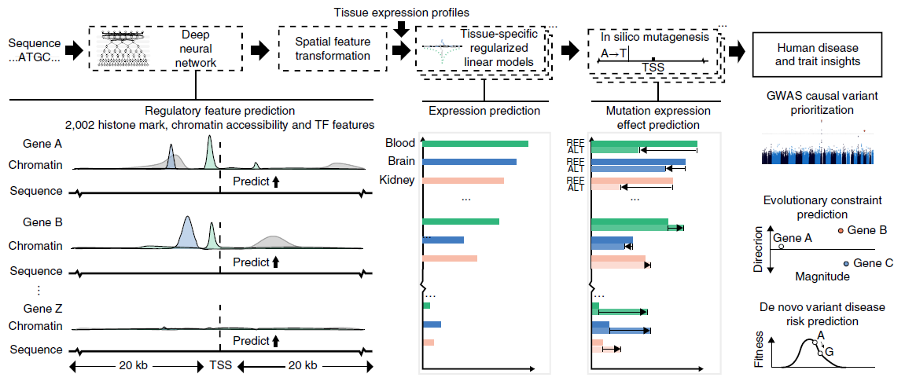
Expecto: a pre-trained ConvNet model to predict 2,002 regulatory features
(Zhou et al, 2018)

Slide 14
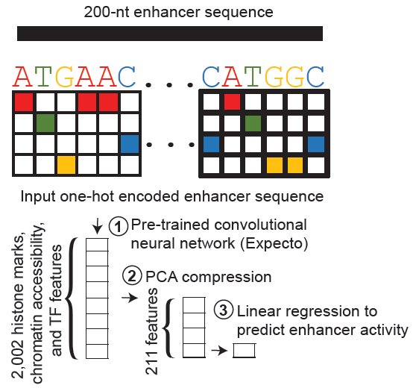
A sequence-based model trained on MPRA data from any cell type

Slide 15
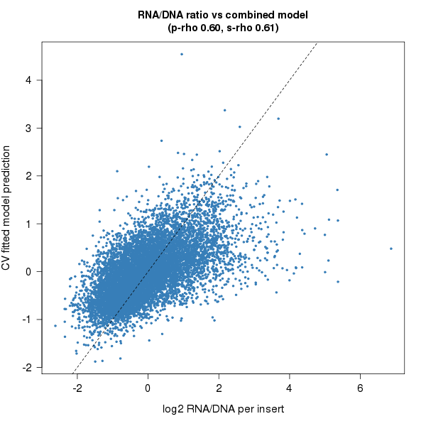
A sequence-based model to predict enhancer efficacy (HepG2 cells)
R^2 = 0.36
Notes:
Foxp1 repressor
Ep300 activating
BCL6 repressor
HDAC6 – deacetylase

Slide 16
HepG2 expanded 170K MPRA

Slide 17
HepG2 expanded library of 164K elements
175 dinucleotide-shuffled negative controls
50 positive and 50 negative synthetically designed controls from Smith et al, 2013
50 positive and 50 negative naturally occurring controls from Inoue et al, 2017
19,104 TSSs, one for every protein-coding gene promoter
12,411 tested in antisense orientation
66,017 candidate enhancers
Identified DNase I hypersensitivity sites common to 2 replicates
Took the subset not overlapping annotated promoters
Tested both in + and - orientations

Slide 18
Reproducibility among replicates

Slide 19
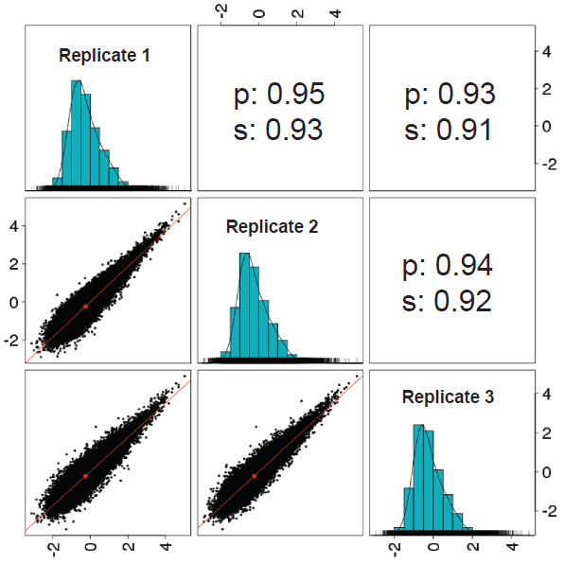
HepG2 library of ~164,000 elements

Slide 20
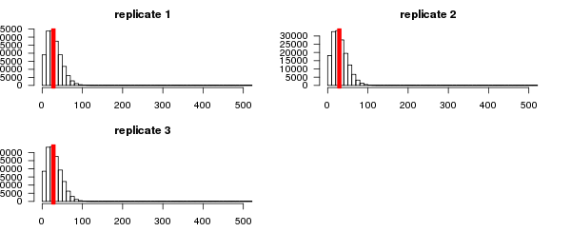
Barcodes / insert in each replicate

Slide 21
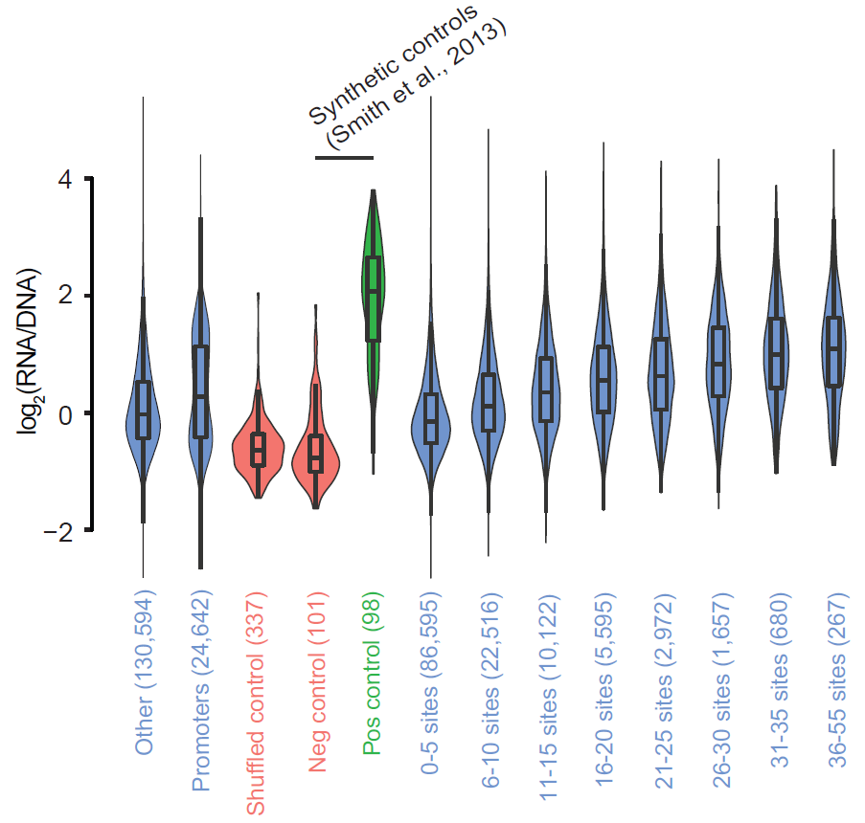
HepG2 library of ~164,000 elements

Slide 22
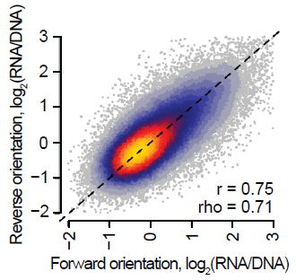
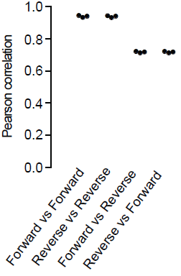
Concordance between orientations tested

Slide 23
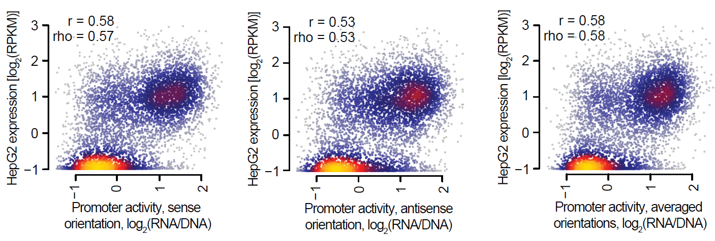
Concordance between MPRA-based promoter activity and endogenous gene expression

Slide 24
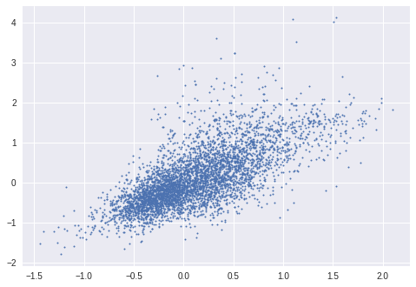
A sequence-based model to predict element activity (HepG2 cells)
R^2 = 0.491
Observed expression
Predicted expression
Predict sense: Test R^2 = 0.428
Predict antisense: Test R^2 = 0.428
Predict avg of sense & antisense: Test R^2 = 0.491

Slide 25
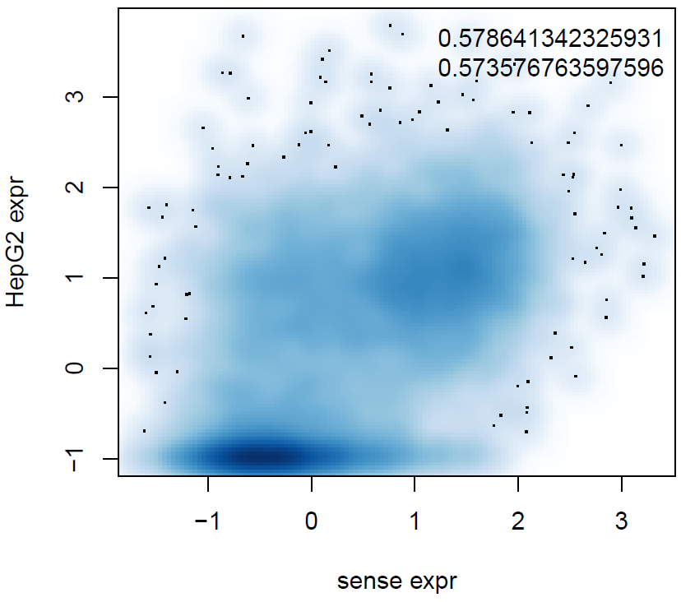
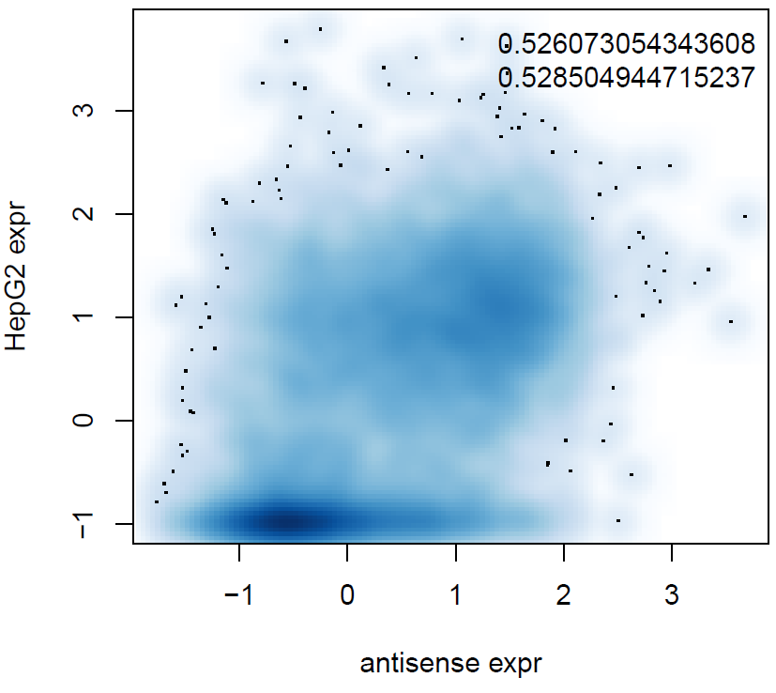
Correlation between all protein-coding gene promoters and endogenous expression; sense=in direction of gene; antisense=opposite r²=0.34

Slide 26
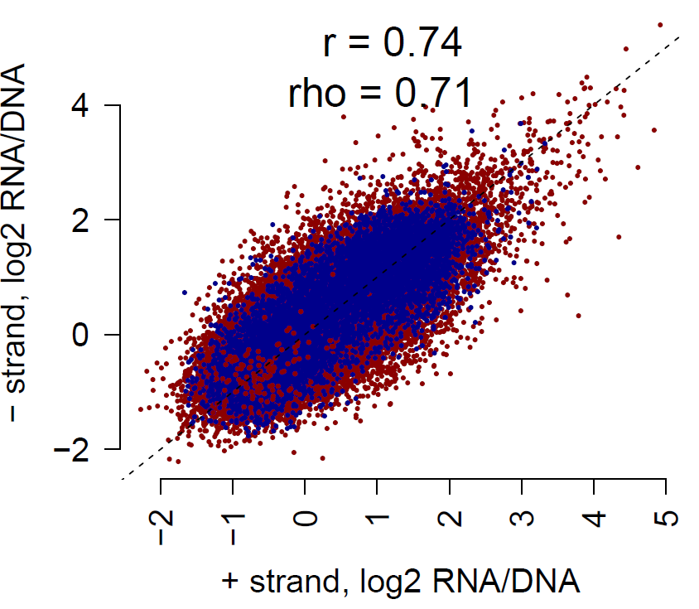
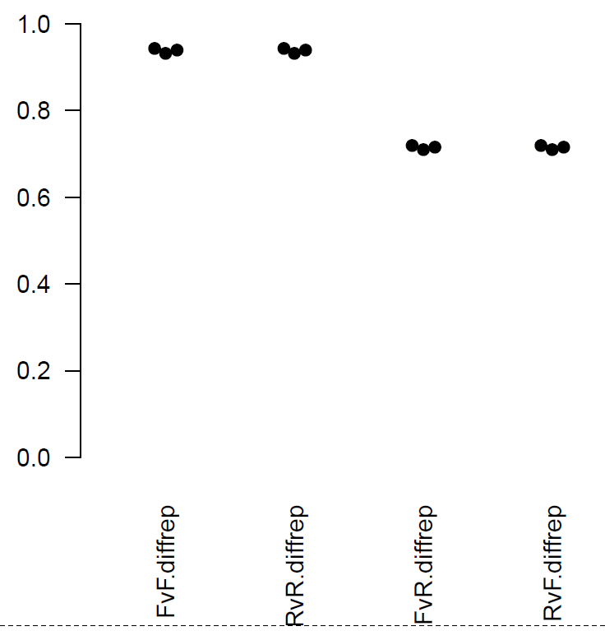
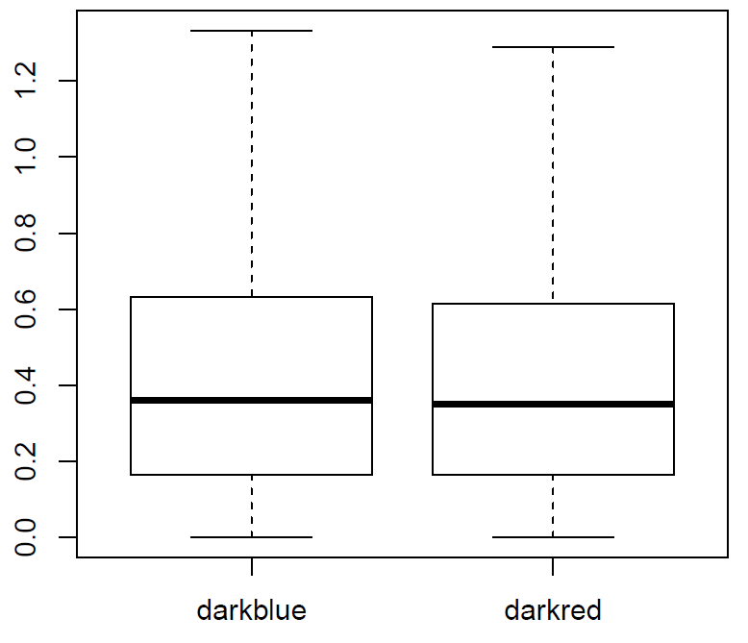
F vs R orientation analysis blue=promoters; red=enhancers
Promoters
Enhancers
Abs(difference
in + and - strands)
Promoters Enhancers
p = 0.026 promoters slightly greater than enhancers

Slide 27
Sequence-only mode based on 2002 Expecto features (compressed w/ PCA to 211 features)
R^2 = 0.491
Observed expression
Predicted expression
Predict sense: Test R^2 = 0.428
Predict antisense: Test R^2 = 0.428
Predict avg of sense & antisense Test R^2 = 0.491

Slide 28
K562 Pilot MPRA

Slide 29
K562 pilot library of ~9,400 enhancers
~200 di-nucleotide shuffled negative controls, ~40 manually selected controls
~200 negative and ~100 positive naturally occurring controls from Ernst et al, 2018
~280 negative and ~260 CRISPRi-tested controls from Gasperini et al. 2019
~6,400 candidate enhancers
Identified DNase I hypersensitivity sites common to 2 replicates
Took the subset not overlapping annotated promoters
Counted number of ENCODE-ChIP-supported TF binding sites overlapping the enhancer, and sampled enhancers from 5 bins
Acquired a sampling of enhancers from across the genome with few and lots of TF binding sites

Slide 30
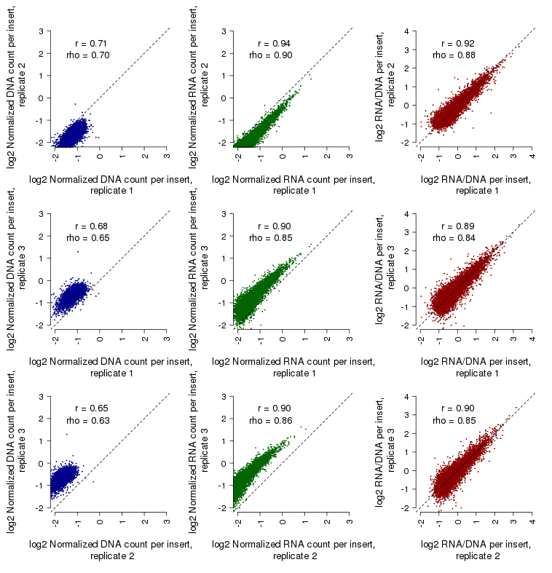
Reproducibility among replicates

Slide 31
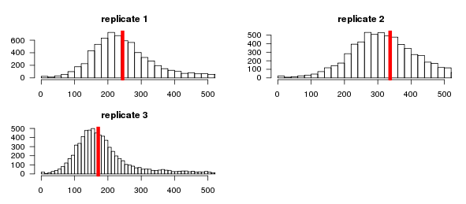
Barcodes / insert in each replicate

Slide 32
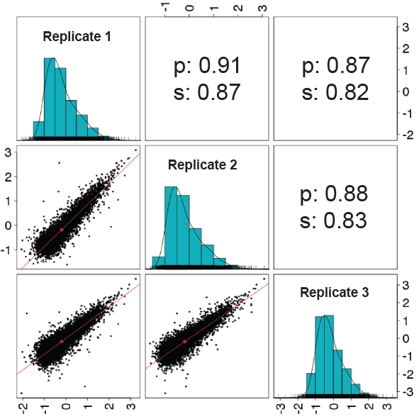
K562 library of ~7,500 enhancers

Slide 33
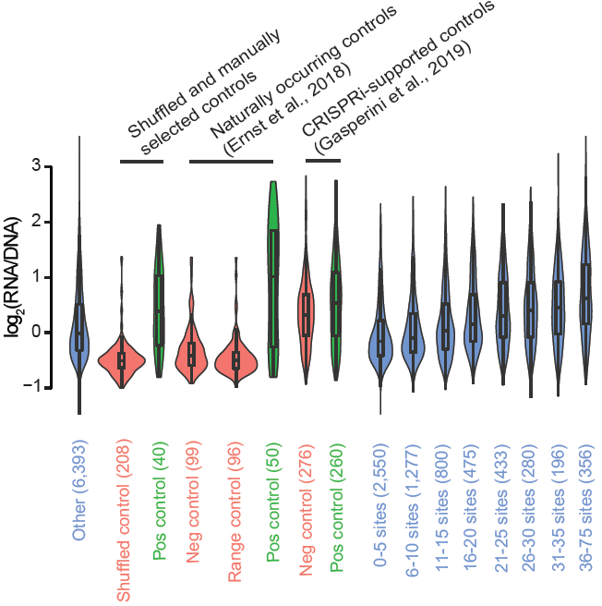
K562 library of ~7,500 enhancers

Slide 34
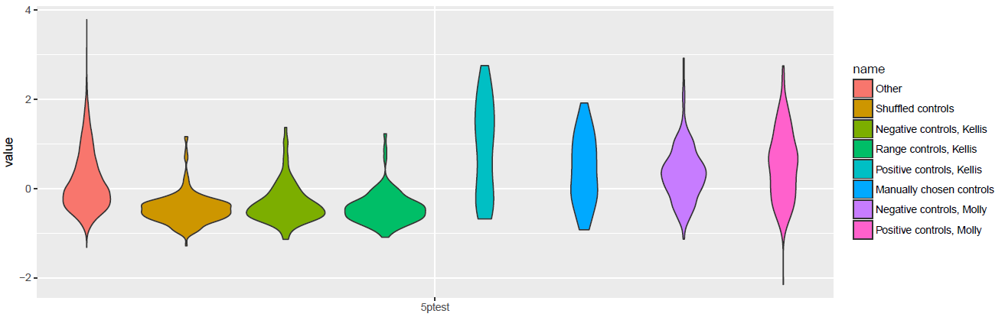
K562 library enhancer activity distributions (controls vs experimental groups)

Slide 35
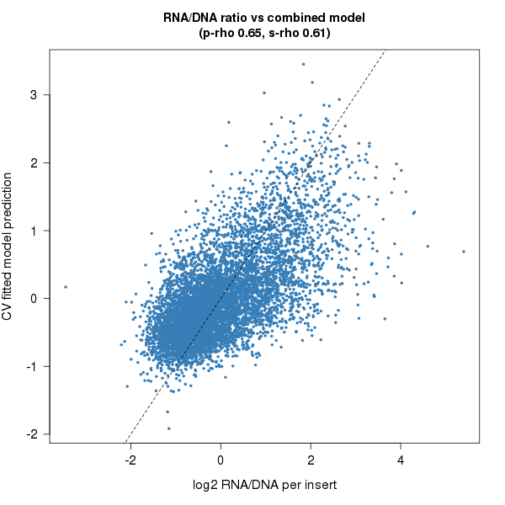
A sequence-based model to predict enhancer efficacy (K562 cells)
R^2 = 0.422
Notes:
Foxp1 repressor
Ep300 activating
BCL6 repressor
HDAC6 – deacetylase

Slide 36
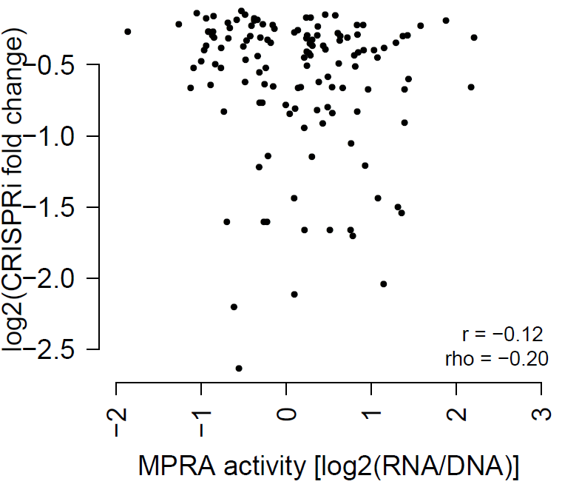
Weak but significant correlation between enhancer activity and fold change via Molly’s CRISPRi

Slide 37
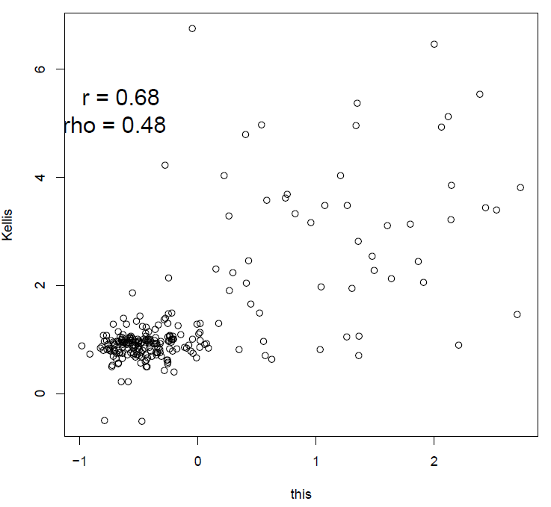
Correlation between all Kellis MPRA data and our MPRA data

Slide 38
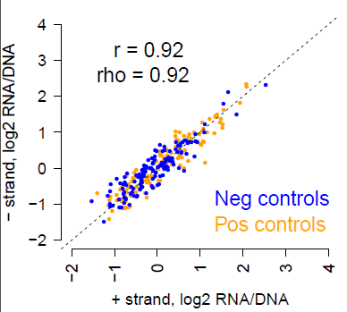
Enhancer orientation doesn’t really matter (CRISPRi controls from Molly’s data)

Slide 39
Sequence-only mode based on 2002 Expecto features (compressed w/ PCA to < 200 features)

Slide 40
K562 expanded 244K MPRA

Slide 41
K562 expanded library of 244K elements
250 dinucleotide-shuffled negative controls
~200 negative and ~50 positive naturally occurring controls from Ernst et al, 2018
19,104 TSSs, one for every protein-coding gene promoter
all tested also in antisense orientation
14,918 for 7 ENCODE loci
~2131 tiles/locus selected by Gurkan's method from the +/- 1Mb of each locus
all tested also in antisense orientation
87,618 candidate enhancers
Derived from an IDR-optimized threshold that combines two UW replicates from a separate ENCODE pipeline from Anshul
Took the subset not overlapping annotated promoters +/- 2500 nt of "basic" set of TSSs
all tested also in antisense orientation

Slide 42
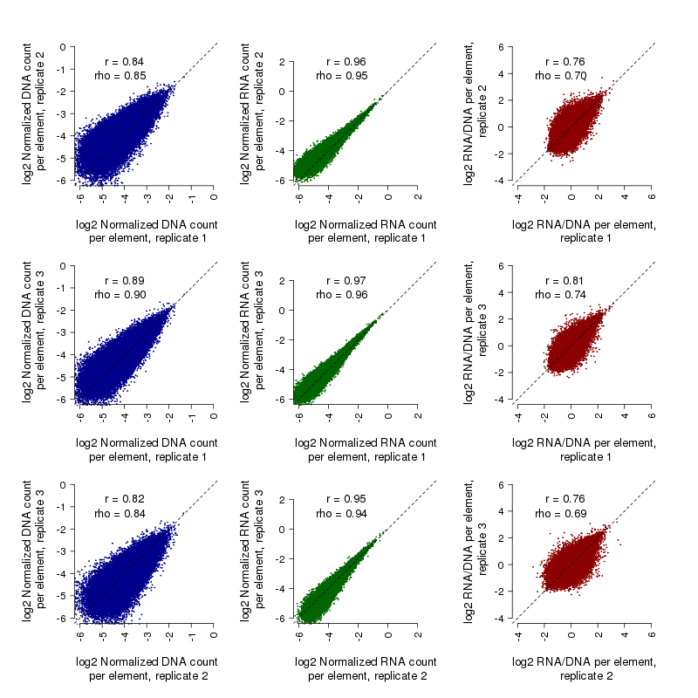
Reproducibility among replicates

Slide 43
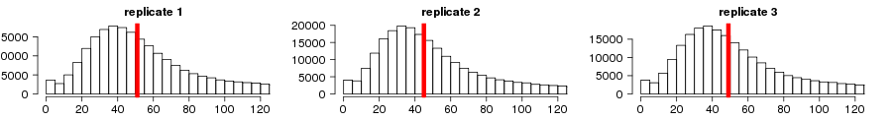
Barcodes / insert in each replicate

Slide 44
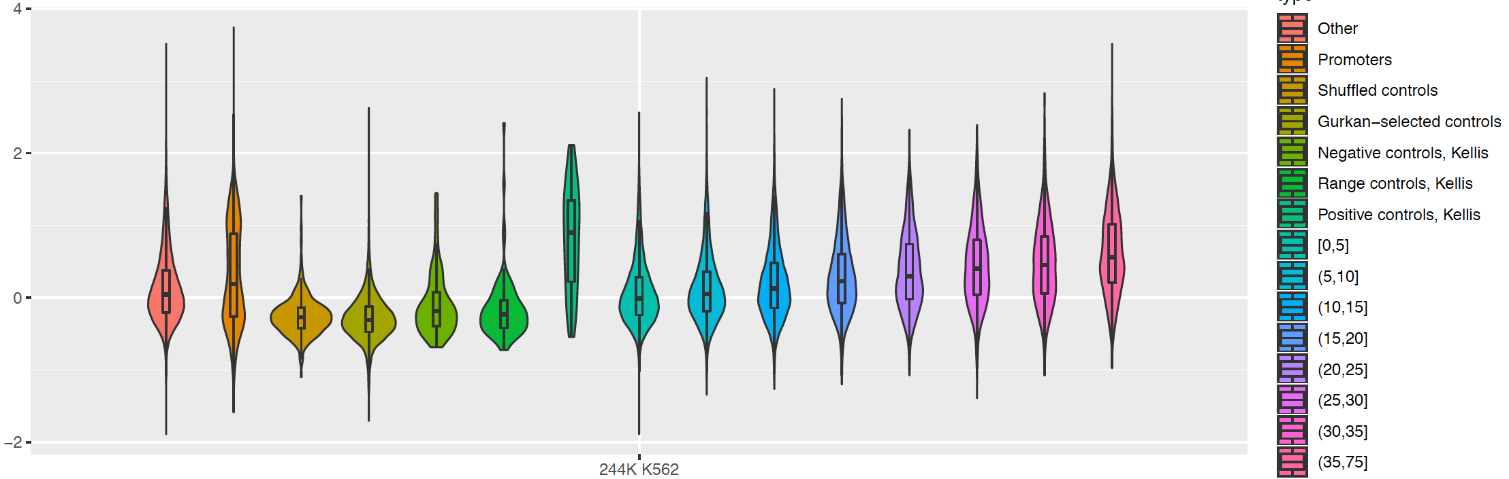
K562 library of ~244,000 elements

Slide 45
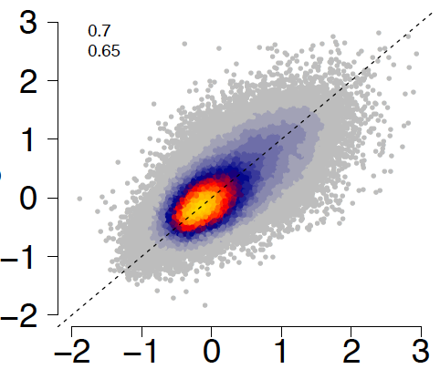
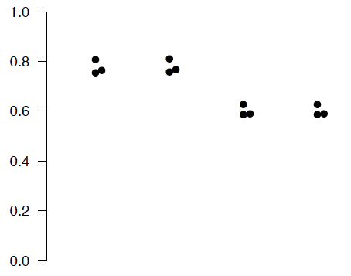
Concordance between orientations tested
r=
rho=

Slide 46
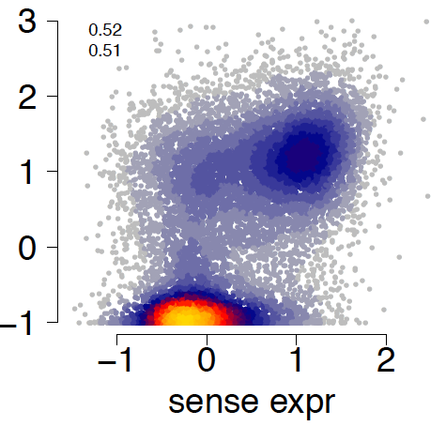
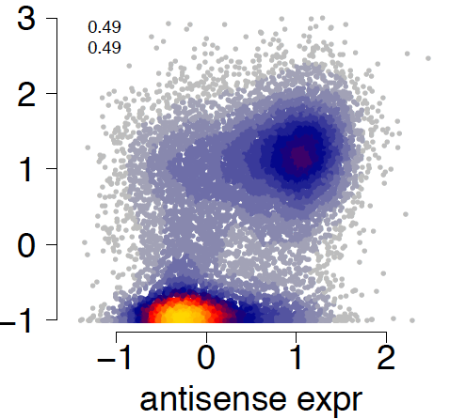
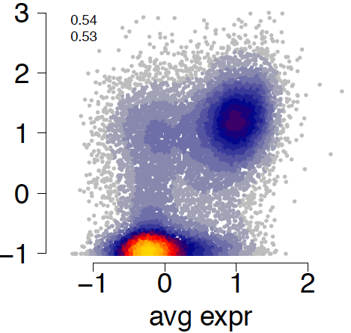
Concordance between MPRA-based promoter activity and endogenous gene expression
r=
r=
r=
K562 expression [log2(RPKM)]
rho=
rho=
rho=

Slide 47
HepG2 9.5K vs K562 7.5K pilot comparison

Slide 48
HepG2 pilot library of ~9,400 elements
50 positive and 50 negative synthetically designed controls from Smith et al, 2013
50 positive and 50 negative naturally occurring controls from Inoue et al, 2017
~9,200 candidate enhancers
Identified DNase I hypersensitivity sites common to 2 replicates
Took the subset not overlapping annotated promoters
Counted number of ENCODE-ChIP-supported TF binding sites overlapping the enhancer, and sampled enhancers from 5 bins
Acquired a sampling of enhancers from across the genome with few and lots of TF binding sites

Slide 49
K562 pilot library of ~7,500 elements
~200 di-nucleotide shuffled negative controls, ~40 manually selected controls
~200 negative and ~100 positive naturally occurring controls from Ernst et al, 2018
~280 negative and ~260 CRISPRi-tested controls from Gasperini et al. 2019
~6,400 candidate enhancers
Identified DNase I hypersensitivity sites common to 2 replicates
Took the subset not overlapping annotated promoters
Counted number of ENCODE-ChIP-supported TF binding sites overlapping the enhancer, and sampled enhancers from 5 bins
Acquired a sampling of enhancers from across the genome with few and lots of TF binding sites

Slide 50
HepG2 (left)/K562 (right) pilot libraries

Slide 51
HepG2 (left)/K562 (right) pilot libraries

Slide 52
HepG2 (left)/K562 (right) pilot libraries, predicted vs actual activity
R^2 = 0.36
R^2 = 0.422
Notes:
Foxp1 repressor
Ep300 activating
BCL6 repressor
HDAC6 – deacetylase

Slide 53
HepG2 164K vs K562 244K comparison

Slide 54
HepG2 164K (left) vs K562 244K (right)

Slide 55
HepG2 164K (left) vs K562 244K (right)

Slide 56
HepG2 164K (top) vs K562 244K (bottom)
r=
r=
r=
rho=
rho=
rho=
K562 expression [log2(RPKM)]

Slide 57
HepG2 164K (left) vs K562 244K (right)

Slide 58
HepG2 164K (left) vs K562 244K (right)
r=
rho=

Slide 59
Conclusions
Our (Shendure & Ahituv) group has successfully designed an MPRA strategy to test nearly 70x more enhancers than we had in the past (a genome’s worth), while maintaining the overall integrity of data quality
We have demonstrated the overall strategy works in two cell lines: HepG2 and K562
A sequence-only model performs practically just as well as one based on biochemical data, but is far faster to train and deploy for genome-wide predictions
Disadvantage of sequence-based models is the difficulty of interpreting model in an as clear a way

